Slide 2
Resources for Startups in NYS

Slide 3
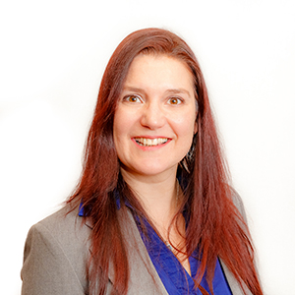
Today’s Presenters
Patty Rechberger
Innovation Fund Manager
Eric Fasser
Solutions Program Manager

Slide 4
Agenda
What Are Resources
Incubators/Accelerators
Where To Find Funding
Legal Matters
CATs & CoEs
MEP Centers

Slide 5
Resources
AVAILABLE TO YOU

Slide 6
What Resources Exist in NYS and Why?
Economic Development is generally a program, set of policies, or activities aimed at building self-sustaining, long-term economic growth.
Empire State Development Corporation (ESD)
https://esd.ny.gov/
ESD’s Division of Science, Technology and Innovation (NYSTAR)
www.esd.ny.gov/doing-business-ny/innovation-development-support

Slide 7
New York State Economic Regions
Capital District
Central New York
Finger Lakes
Long Island
Mid-Hudson
Mohawk Valley
New York City
North Country
Southern Tier
Western New York

Slide 8
Develop An Idea
WHERE TO NOW?

Slide 9
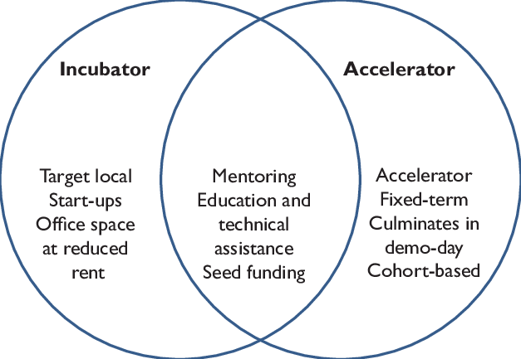
Incubating Is Not Just for Eggs
NextCorps (Finger Lakes) - https://nextcorps.org/
BioInc (Mid-Hudson) - http://www.bioincny.com/
WIN (Western NY) - http://www.wnyincubators.com/
Long Island High Tech Incubator (LIHTI) - https://lihti.net/
Tech Garden (Central NY) - https://www.thetechgarden.com/
North Country Incubator - https://northcountryhotspot.com/
Startup Alliance (Southern Tier) - https://www.ststartup.com/
Thincunator (Mohawk Valley) - https://thincubator.co/
Innovate 518 (Capital Region ) - https://www.innovate518.com/
NYCRIN (NYC) - https://www.nycinnovationhotspot.org/
Source: Bliemel et al. (2016, p. 14).
https://esd.ny.gov/certified-business-incubator

Slide 10
Funding
AVAILABLE SOURCES

Slide 11
Business Competitions
Genius NY (Central NY) – uncrewed systems, IoT, robotics & big data http://www.geniusny.com/
FuzeHub Commercialization Competition –prototype stage manufacturer https://fuzehub.com/commercialization-competition/
Luminate (Rochester) – accelerator (photonics, IoT, energy, quantum, etc.) https://luminate.org/
43North (Buffalo) – accelerator (startups) https://www.43north.org/
76West (Southern Tier) – clean energy https://www.nyserda.ny.gov/76west
HUSTLE Defense Accelerator (Rome) – national security (AI, machine learning, cyber) https://www.griffissinstitute.org/what-we-do/hustle
Grow NY (Central New York, Finger Lakes, Southern Tier) – food & ag https://www.grow-ny.com/
Notes:
8 competitions in NYS
*
* Commercialization Competition

Slide 12
Other Sources of Funding for Startups
Grants
FuzeHub Manufacturing Grants
JumpStart Program (Cornell Center for Materials Research)
Small Business Innovation Research (SBIR)
Small Business Technology Transfer (STTR)
Crowd Funding
Angel Groups
Venture Capital
Upstate Capital Association of NY
NY Ventures
Launch NY
Notes:
8 competitions in NYS
*
* Commercialization Competition

Slide 13
Legal Matters
IP PROTECTION

Slide 14
NYS Science & Technology Law Center
New York State Science & Technology Law Center (NYS-STLC) at Syracuse University College of Law
IP Protection
Patents
Trade secret
Copyright
Trademark

Slide 15
NYS Science & Technology Law Center
IP Strategy
Should you file a patent? When?
Financial implications
Research Services
Prior art searches
Competitive landscape
Assess freedom-to-operate risks
Help assessing the strength of claims and likelihood of obtaining a patent
Foreign filing considerations

Slide 16
CATs & CoEs
APPLIED RESEARCH

Slide 17
Centers for Advanced Technology (CATs)
Encourage collaboration between private industry and universities to advance the development and application of new technologies.
15 centers in strategically important technology fields
Nanomaterials & Nanoelectronics | Flexible Hybrid Medical Devices | Big Data & Health Sciences
Integrated Electric Energy Systems | Integrated Electronics | Future Energy Systems
Emerging & Innovative Sciences | Materials Processing | Additive Manufacturing
Telecommunications | Life Sciences | Engineering
Biotechnology | Sensors | Ceramics

Slide 18
Centers of Excellence (CoE)
Foster collaboration between the academic research community and the business sector to develop and commercialize new products and technologies.
14 centers in emerging technology fields
Atmospheric & Environmental Prediction & Innovation | Healthy Water Solutions | Wireless & Info Technology | Nanoelectronics & Nanotechnology
Advanced & Sustainable Manufacturing | Food & Agriculture Innovation | Digital Game Development | Environmental & Energy Systems
Small Scale Systems Integration & Packaging | Advanced Energy Research | Materials Informatics | Bioinformatics & Life Sciences
Precision Medicine & Responses to Bioterrorism & Disasters |  |  | Data Sciences

Slide 19
MEP Centers
NYMEP

Slide 20
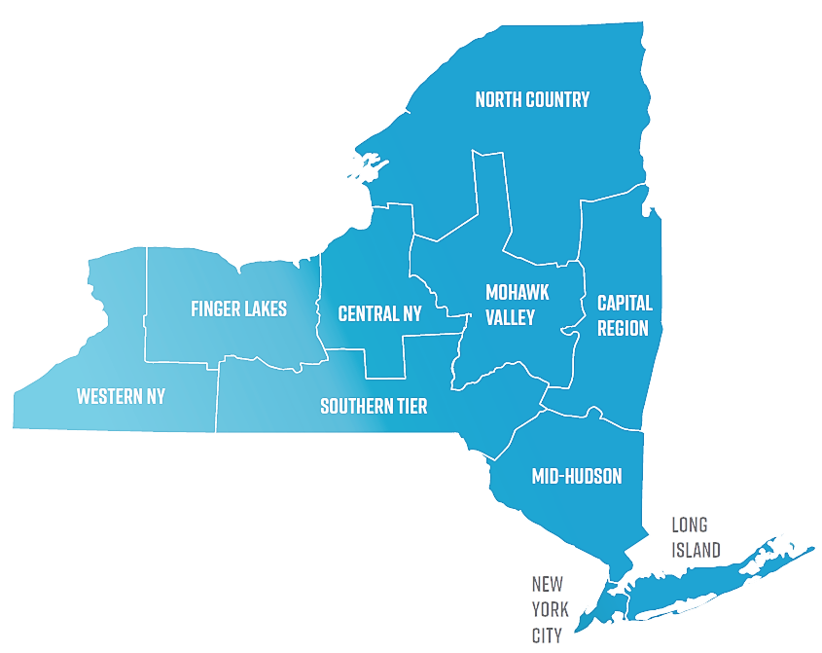
Manufacturing Extension Partnership Centers
Help NY-based manufacturers and technology companies
10 regional centers
FuzeHub (statewide)

Slide 21
Manufacturing Extension Partnership Centers
SERVICES
Business Assessment
Strategic Planning
Project Management
Certifications/Audits
Engineering / CAD
Product / Process Development
Workforce Development
Marketing
Cybersecurity
Lean Training
Funding Options

Slide 22
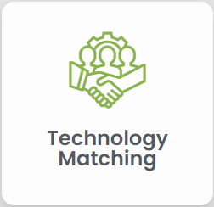
Manufacturing Extension Partnership Centers
FuzeHub Solutions Program
Guided access to:
NYS-STLC
CATs and CoEs
Regional MEP Centers
Other Resources:
Vetted Contract Manufacturers
I-Corps
Regulatory Agencies
Funding Sources
Speak to An Expert > >
www.fuzehub.com home page

Slide 23
Thank You
Patty Rechberger
Innovation Fund Manager
patty@fuzehub.com
Eric Fasser
Solutions Program Manager
eric@fuzehub.com
www.fuzehub.com

